Slide 1



API part 1
Integrative Programming

Slide 2



Outline
Types of API
Authentication vs Authorization
www.its.ac.id
INSTITUT TEKNOLOGI SEPULUH NOPEMBER, Surabaya - Indonesia

Slide 3
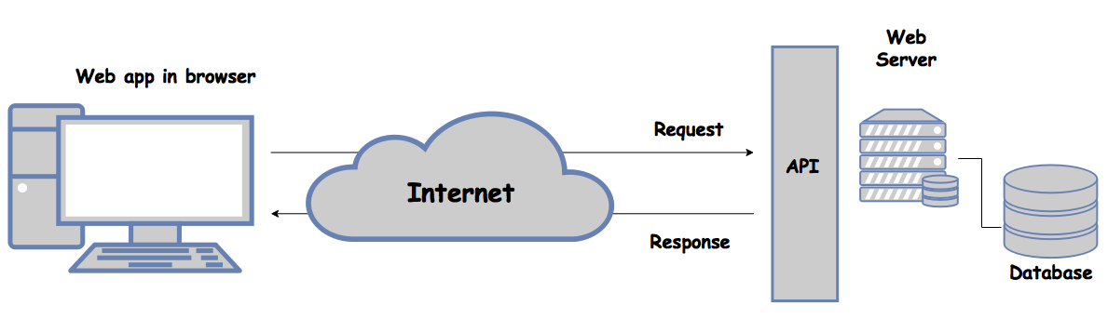
What is API?
API (Application Programming Interface)
Allows different software to interact with a simple set of commands
One program can call another program’s API to get access to the data or functionality of the other program
Can speed up the development process
www.its.ac.id
INSTITUT TEKNOLOGI SEPULUH NOPEMBER, Surabaya - Indonesia

Slide 4
What is API?
API consist of two components
Technical specification
Software interface
www.its.ac.id
INSTITUT TEKNOLOGI SEPULUH NOPEMBER, Surabaya - Indonesia

Slide 5
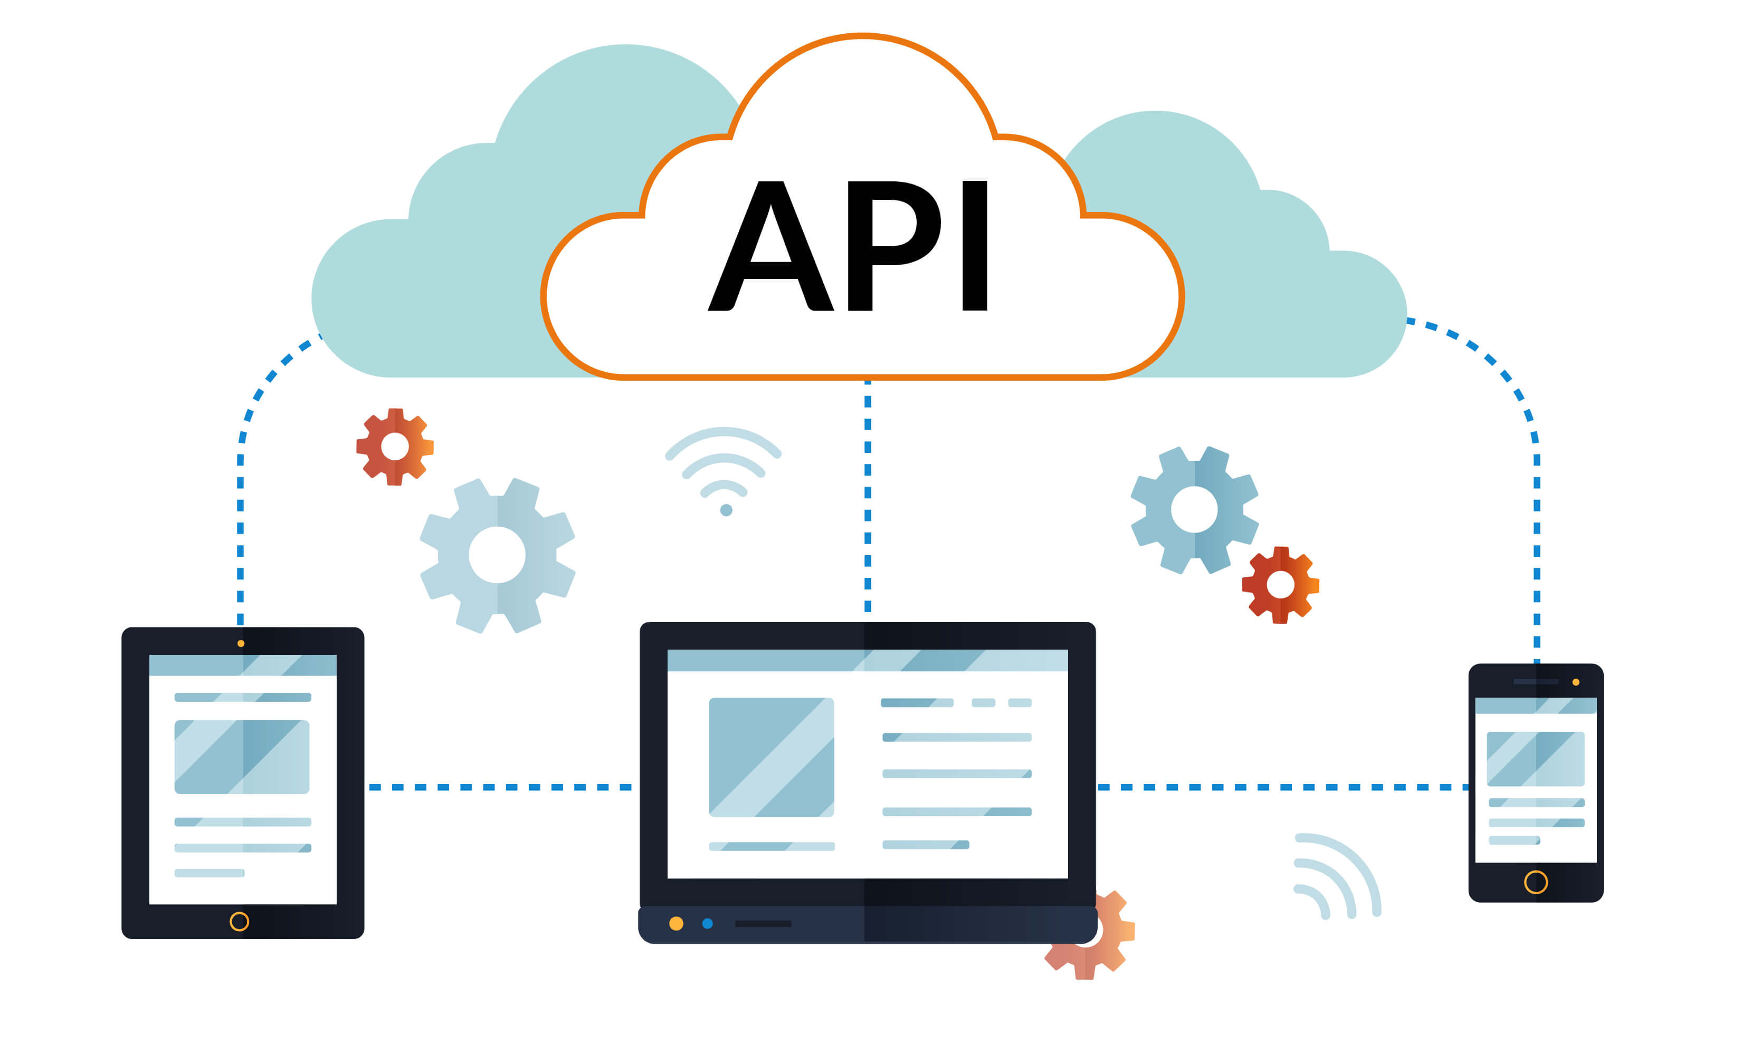
Type of API
Open APIs or Public API
No restriction
Publicly available
Partner API
A developer need specific license to access the API
Not available to the public
Internal API or Private API
Only internal system can use this API
Usually used inside a company
Composite API
Combine different data and service APIs
www.its.ac.id
INSTITUT TEKNOLOGI SEPULUH NOPEMBER, Surabaya - Indonesia

Slide 6
Types of API by use case
Database APIs
It enable communication between an application and a DBMS
Operating systems APIs
It defines how applications use the resources and services of OS
Remote APIs
Web APIs
It defines standards of interaction for application running on different machines
Every OS has its set of APIs
Application access resource located outside the device
The most common
Represent client-server architecture
www.its.ac.id
INSTITUT TEKNOLOGI SEPULUH NOPEMBER, Surabaya - Indonesia

Slide 7
Types of API by protocol
Representation State Transfer (REST)
Simple Object Access Protocol (SOAP)
Architecture style with loose guidelines and recommendations
Data-driven
Need less bandwidth
Support multiple format e.g. XML, plain text, JSON
Caching is possible
Stateless
Protocol of specific structure with predefine rules to follow
Function-driven
Use more bandwidth over the internet
Support only XML
Caching not possible
Stateful
www.its.ac.id
INSTITUT TEKNOLOGI SEPULUH NOPEMBER, Surabaya - Indonesia

Slide 8
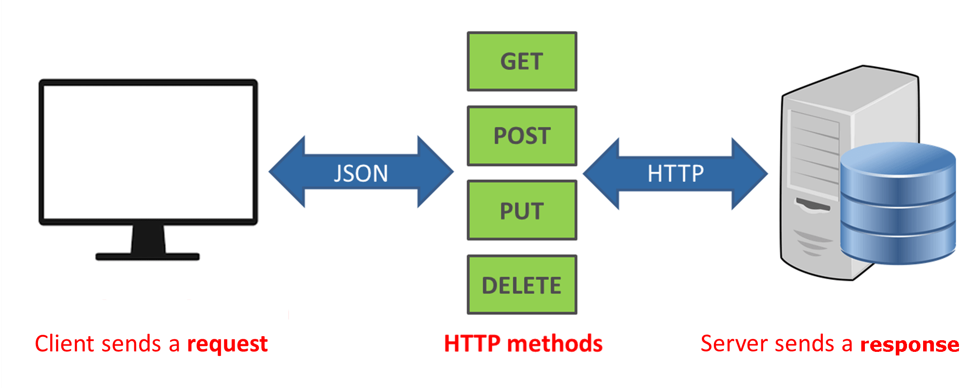
REST API
REST APIs also known as RESTful API is API that comforts to the constraints of REST architectural style
Provide a flexible, lightweight way to integrate applications
Example: Twitter API, Google API
www.its.ac.id
INSTITUT TEKNOLOGI SEPULUH NOPEMBER, Surabaya - Indonesia

Slide 9
REST API
REST APIs design principle:
Uniform interface
Standard HTTP actions and errors
Using methods GET, PUT, POST, DELETE with standard meaning
Client-server
Client-server architecture
Client and server independent
Stateless
Each request stand alone
www.its.ac.id
INSTITUT TEKNOLOGI SEPULUH NOPEMBER, Surabaya - Indonesia

Slide 10
REST API
REST APIs design principle:
Cache ability
Enable response to cache, so that it can be reused for later similar request
Layered system architecture
The requests and responses go through different layer
Code on demand
In certain cases, response can contain executable code
The code only run on-demand
www.its.ac.id
INSTITUT TEKNOLOGI SEPULUH NOPEMBER, Surabaya - Indonesia

Slide 11
SOAP API
SOAP stands for Simple Object Access Protocol
Use XML format to declare its request and response messages
SOAP API is independent from programming language
Example: the sender can use C#, while the recipient use Java
Standard SOAP API requests and responses are appear as an envelop message
www.its.ac.id
INSTITUT TEKNOLOGI SEPULUH NOPEMBER, Surabaya - Indonesia

Slide 12
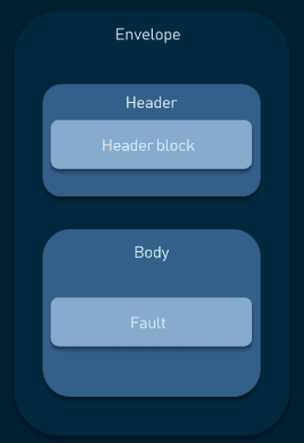
SOAP API
Envelope
The root element of a SOAP message
Header
Provide information about the messages, e.g. Authentication
Body
The request and response
Fault
Shows error messages
www.its.ac.id
INSTITUT TEKNOLOGI SEPULUH NOPEMBER, Surabaya - Indonesia

Slide 13
API integration
API integration use to establish a seamless connectivity between various components, e.g. software, application, system, etc
API integration is important:
Building something that leverage costumer need
Migration from product to ecosystems
www.its.ac.id
INSTITUT TEKNOLOGI SEPULUH NOPEMBER, Surabaya - Indonesia

Slide 14
Authentication
Authentication
When an entity proves identity, use as identifier
Can use as an evidence that ensure the user is the right user
Refers to proving correct identity
Example in non-technical
Driver license → issues by a trusted authority (police officer), use as evidence to allow us driving a vehicle
www.its.ac.id
INSTITUT TEKNOLOGI SEPULUH NOPEMBER, Surabaya - Indonesia

Slide 15
Authorization
Authorization
When an entity proves a right to access something
Proves that the client has the right to make a request
Example: certain user only have access to read resource but not modify the resource
www.its.ac.id
INSTITUT TEKNOLOGI SEPULUH NOPEMBER, Surabaya - Indonesia

Slide 16
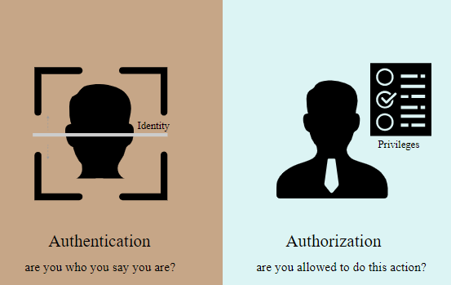
Authorization vs Authentication
An API might authenticate client but not authorize to make certain request
www.its.ac.id
INSTITUT TEKNOLOGI SEPULUH NOPEMBER, Surabaya - Indonesia
Notes:
https://idratherbewriting.com/learnapidoc/docapis_more_about_authorization.html

Slide 17
Authentication methods
HTTP authentication Schemes
Basic
Bearer
Etc.
API Keys
OAuth
www.its.ac.id
INSTITUT TEKNOLOGI SEPULUH NOPEMBER, Surabaya - Indonesia

Slide 18
Authentication methods
Basic authentication
Security vulnerability
The most straight forward method and the easiest
The sender places username and password into the request header
Username and password encode with base 64
It does not require cookies, session ID, login pages
www.its.ac.id
INSTITUT TEKNOLOGI SEPULUH NOPEMBER, Surabaya - Indonesia

Slide 19
Authentication methods
Bearer authentication
Involve security tokens called bearer tokens
The bearer token allowing access to a certain resource or URL and most likely is a cryptic string
Usually generate by server in response to a login request
The client must send the token in authorization header when making request
Should only be used over HTTPS
www.its.ac.id
INSTITUT TEKNOLOGI SEPULUH NOPEMBER, Surabaya - Indonesia

Slide 20
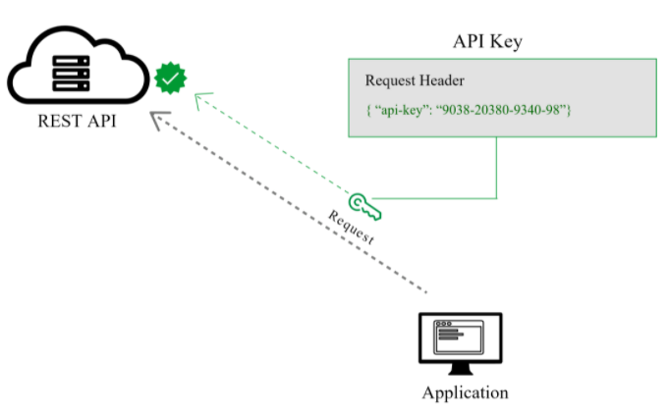
Authentication methods
API keys
A unique generated value is assigned to each first time user
When the user re-enter the system, the unique key is used to prove that they are the same users as before
API keys are simple
It can be placed:
Authorization header
Body data
Custom header
Query string → not recommended, show in URL, can easily discover by someone else
www.its.ac.id
INSTITUT TEKNOLOGI SEPULUH NOPEMBER, Surabaya - Indonesia

Slide 21
Authentication methods
API keys
Benefits:
Security: randomly generated
Performance: work up to 10x faster than using username and password
Longevity: do not expire automatically
www.its.ac.id
INSTITUT TEKNOLOGI SEPULUH NOPEMBER, Surabaya - Indonesia

Slide 22
Authentication methods
OAuth (2.0)
OAuth 2.0 is the industry-standard protocol for authorization
OAuth2 works with authentication scenarios called flows, these flows include:
Authorization Code flow
Implicit flow
Resource Owner Password flow
Client Credentials flow
www.its.ac.id
INSTITUT TEKNOLOGI SEPULUH NOPEMBER, Surabaya - Indonesia

Slide 23
TERIMA KASIH

